Slide 1
Introduction
CISC 3220 Algorithms Lecture 1
By Ariel Avshalom

Slide 2
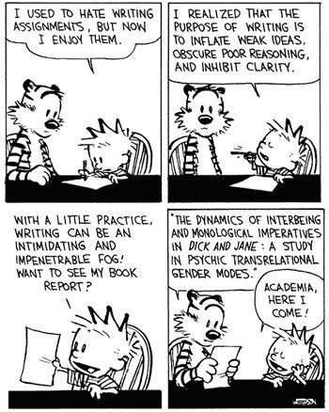
What is a proof?
A rigorous sequence of statements which are either known (axioms) or derived from previous steps (lemma) with the conclusion showing the truth of the original statement
The process of establishing the validity of a statement by derivation from other statements
A bunch of other definitions that mean the same thing
Essentially, show something is true using logic

Slide 3


Some important proofs (because why not?)
Prove: There are infinitely many prime numbers
Let p1 < p2 < · · · < pn be a set of n primes.
Let Q = p1p2…pn + 1
If Q is prime then a new prime is found
Otherwise from FTOF (fundamental theorem of arithmetic), Q is a product of 2 or more primes
None of these primes can be p1,p2,…,pn
Therefore we found a new prime
And we can play this game till the end of time
(or at least until dinner time)

Slide 4

Wait, why do we care about proofs again?
This course employs many techniques taught in discrete math to prove the correctness of an algorithm
These techniques include:
Direct proofs
Contradiction
Loop invariants
Induction
A whole menagerie of other things

Slide 5
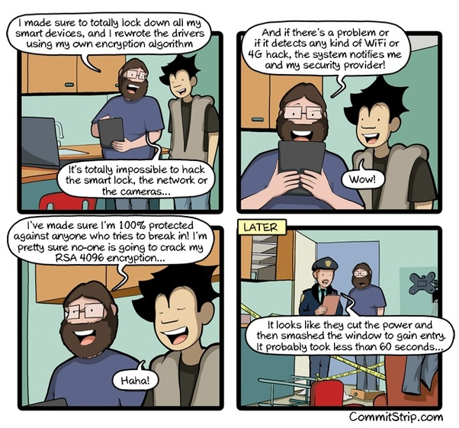
Why does correctness matter?
Let’s say you graduate and get a job at a sweet FAANG company
Then your manager tells you:
Hey Joe, I need you to write a program that can sort this Phyloseq data in O(n*log(log(n))) time
If you tell your boss that you can’t do it, it’ll be hard to justify why you’re paid your six-figure salary
But if you can prove that its not possible, you’ve shown that you deserve to be there

Slide 6

As above
Proving things is hard
It might be possible to account for many things, but if you don’t account for everything, you’ll end up like the guy in the comic

Slide 7
What’s an algorithm?
Now that that’s out of the way
Does anyone remember what al algorithm is?

Slide 8
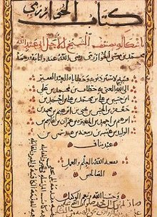
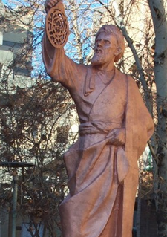
Brief history lesson
The Latinized word algorithm comes from the name Muhammad ibn Musa al-Khwarizmi, who is The “Father” of Algorithms
It was improved on over time and eventually formulized by Alonzo Church + Alan Turing (and others as well)

Slide 9

Elements of an algorithm
A finite sequence of
Well-defined
Computer-implementable instructions
Typically used to solve a class of problems or to perform a computation
Algorithms are always unambiguous and are used as specifications for performing
Calculations
Data processing
Automated reasoning
Other tasks

Slide 10

In short
An algorithm guarantees a solution to a problem
Note that it doesn’t guarantee a “fast” solution or even a very useful one
We use proofs to show that an algorithm will solve a problem
Analysis of algorithms analyzes how many resources a problem takes

Slide 11
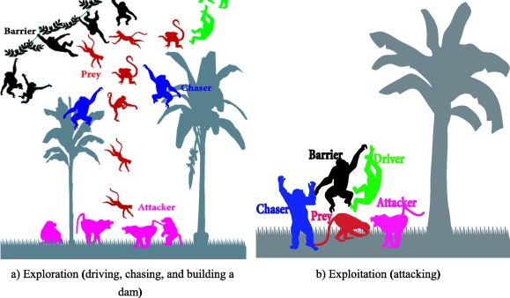
Defining the word algorithm
A finite set of precise instructions for performing a computation or for solving a problem.
Alternatively:
A word used by programmers when they do not want to explain what they did.
A word used by those whose program failed to justify what they did.
TLDR: if you’re going to cheat (in real life or here), make sure you understand what you borrowed

Slide 12
What does it take to solve a problem
It often takes a mix of
Talent
Intuition
Hard work
Experience
Luck
Oftentimes, SWEs can be bashing their heads for days until a little bit of intuition (or inspiration) allows them to find a solution

Slide 13

Algorithm properties
Correctness: which inputs would return valid results?
Complexity: what are the time/space costs of running the algorithm?
Scalability: does the efficiency change with different input sizes?
Limitations: when is this algorithm no longer correct/inefficient?
Optimality: what is the approximately optimal solution and does the algorithm achieve it?

Slide 14

Pseudocode
Going with the concept of algorithms is pseudocode or step by step instructions in a quasi-English (or other human language) outline
Your task: watch this video and write up some pseudocode to translate the steps into a solution

Slide 15
Example pseudocode
Set total to zero
Set grade counter to one
While grade counter is less than or equal to ten
Input the next grade
Add the grade into the total
endwhile
Set the class average to the total divided by ten
Print the class average.

Slide 16
Can we learn everything?
One of the key concepts we teach in this course is that there are always new problems and techniques out there
We can’t learn everything here, but my goal isn’t that
My goal is to train you to think algorithmically so that you can apply knowledge from this class to real world problems
Chances are, we won’t learn things like dynamic or linear programming, but hopefully you’ll be able to use the skills gained here to learn these topics yourself

Slide 17

Sorting
One of the first things any decent algorithms course teaches you is sorting
Generally, there are two parts of any sortable data:
Keys and satellite information
Keys are going to be what you sort on
Satellite information is what you’re packing with those keys
Example: a key could be a website or id and content involving the website/id is satellite information
For this course we’ll be working with key-only information
In courses like this, the basic example is what we tend to use as a model for real world information

Slide 18
Insertion sort
Input: an unsorted list/array of elements
Output: a sorted list of elements
Pseudocode: We’ll write it up in the class notebook
Example: check out the video feed
I have blocks!
Correctness: a loop invariant

Slide 19
Insertion sort correctness
Loop invariants have 3 main parts:
Initialization: is it true before we start?
Maintenance: is it true during each iteration of the loop?
Termination: will it terminate in a useful way once finished?
What are they for this problem?
Refer to here for a clear explanation

Slide 20

Some background info

Slide 21


What is a loop?
I’m sure all of you think you know what it is by now…
But let's cover it just in case ☺

Slide 22

Back to the basics: a Statement
Recall that a statement is
a meaningful declarative sentence that is true or false
OR
the assertion that is made by a true or false declarative sentence
Statements follow one another in a specific order called control flow
This all stems from the concept of structured programming which have if/else and repetition blocks coded in

Slide 23
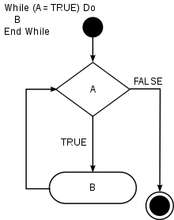
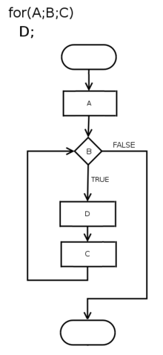
Types of Loops
There are a few types of loops we generally see in CS but here are the main ones:
While
For
Infinite
x = 0.1
while x != 1:
print(x)
x += 0.1
WHAT IS WRONG?
Variable Types

Slide 24
So what is a loop invariant?
All about Lambda Calculus
Before we ask that, we should define which paradigm loop invariants fall under
That paradigm is functional programming
Functional Programming involves building the structure of your code to be exact and never outputting a different result if you insert the same inputs
NOTE: when you code normally, different results happen when you don’t close a file, or you log in as a different user (for example)
This does not happen with functional programming
It’s more difficult to code in, but it is a much more robust way of programming
Languages that adhere to Functional Programming include Haskell and Erlang
Functional Programming can also be implemented in the popular languages like Python and Java

Slide 25


Loop invariant
A loop invariant might have come from the ideas of functional programming, but it can be used everywhere and it has a lot of practical applications
Imagine you’re in a while loop right now
fights = 0
currentFight = 0
while fights < 10:
summon(dragon) #predefined code to summon a dragon
currentFight = fight(player, dragon) #predefined fight initiator code
if currentFight == 1:
print(“winner! “, 10-fights, “ …
…more rounds to go\n!”)
currentFight = 0
fights += 1
else:
print(“You Lost!\n”)
exit()
print(“Game Over”)

Slide 26
A loop invariant does this:
Before the loop starts the loop invariant is true
During the loop, the invariant is checked for truth
When the loop ends, the invariant is no longer true, or
The invariant breaks the loop when its false
In our example before, the invariant was fights, specifically while fights < 10, keep on running the loop
It was true throughout running the loop and once fights = 10, the invariant is no longer true and we exit the loop

Slide 27

Loop invariant for insertion sort
Try producing it yourself
Think, what is the property our loop invariant relies on?
There are 3 parts (with the middle part usually being the most complicated)
Initialization: is the invariant true prior to the first iteration?
Maintenance: if true before an $i^{th}$ iteration, it remains true before the $i^{th}+1 iteration \left(think induction\right)$
Termination: When the loop terminates , the invariant gives us some useful property that lets us show the algorithm is correct

Slide 28

Insertion sort property we’re interested in
At the start of each iteration of the for loop, the subarray $A[1,…,j−1]$ consists of elements originally in $A[1,…,j−1]$ but in sorted order

Slide 29
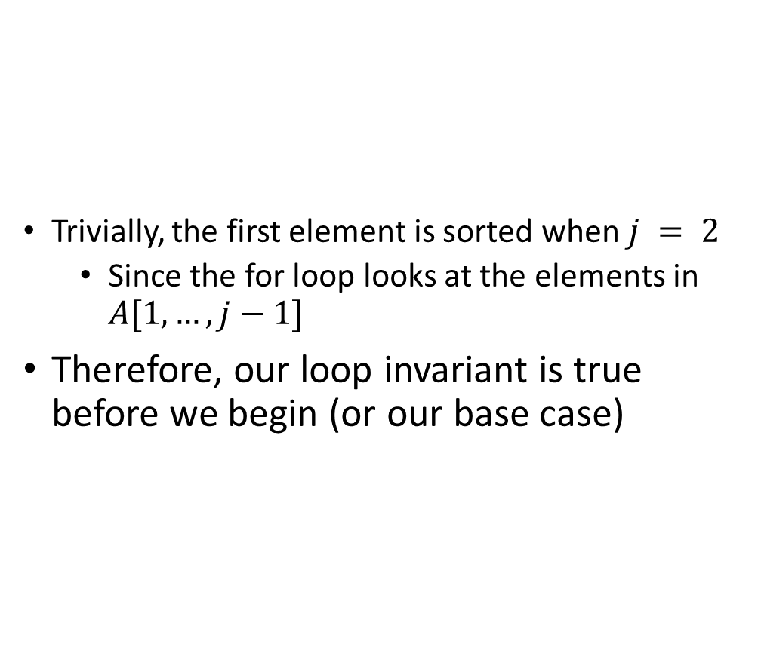
Initialization
Trivially, the first element is sorted when $j = 2$
Since the for loop looks at the elements in $A[1,…,j−1]$
Therefore, our loop invariant is true before we begin (or our base case)

Slide 30
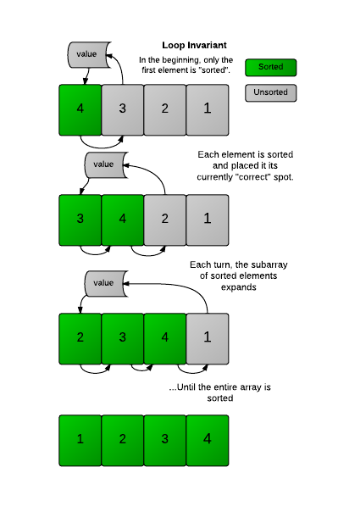

Maintenance
Show that each iteration maintains the loop invariant
In the base case we showed that the subarray was sorted
At each iteration of the while loop, we are comparing the $j^{th}$value with a $j−i$ value until we find the position of that value
When the current for loop iteration is complete, the subarray expands and all the values in it are sorted
Therefore at each iteration, the loop invariant is maintained

Slide 31
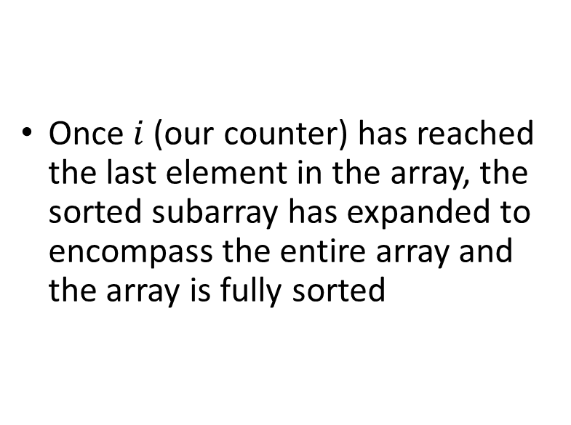
Termination
Once$i$(our counter) has reached the last element in the array, the sorted subarray has expanded to encompass the entire array and the array is fully sorted

Slide 32
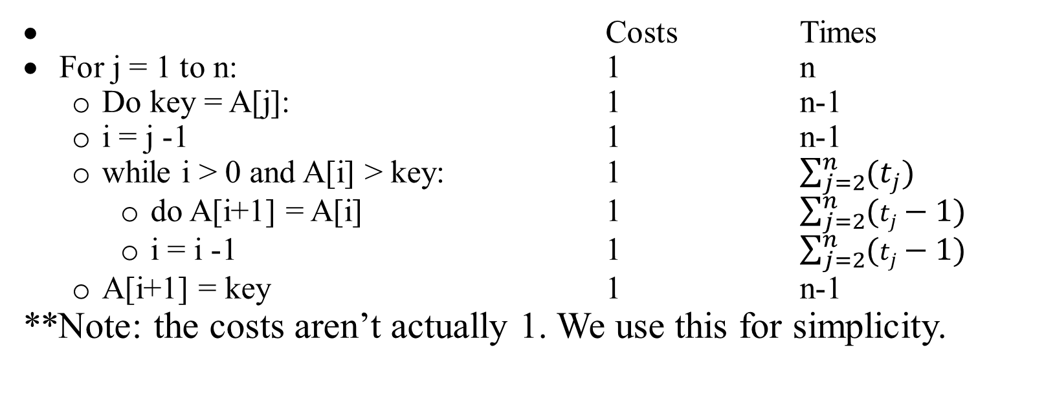
Analyzing insertion sort
Costs Times
For j = 1 to n: 1 n
Do key = A[j]: 1 n-1
i = j -1 1 n-1
while i > 0 and A[i] > key: 1 $\sum_{j=2}^{n}{(t_{j})}$
do A[i+1] = A[i] 1 $\sum_{j=2}^{n}{(t_{j}−1)}$
i = i -1 1 $\sum_{j=2}^{n}{(t_{j}−1})$
A[i+1] = key 1 n-1
**Note: the costs aren’t actually 1. We use this for simplicity.

Slide 33
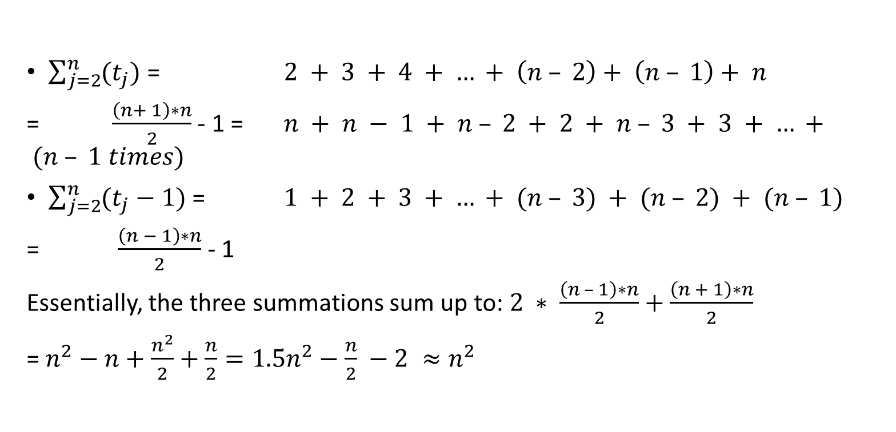
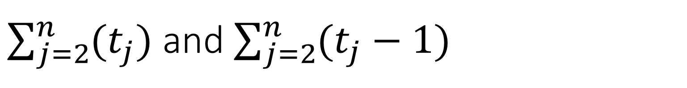
$\sum_{j=2}^{n}{(t_{j})}$ and $\sum_{j=2}^{n}{(t_{j}−1)}$
$\sum_{j=2}^{n}{(t_{j})}$ = $2 + 3 + 4 + … + \left(n – 2\right)+ \left(n – 1\right)+ n$
= $\frac{\left(n+ 1\right)∗n}{2}$ - 1 = $n + n − 1 + n – 2 + 2 + n – 3 + 3 + … + (n – 1 times)$
$\sum_{j=2}^{n}{(t_{j}−1)}$ = $1 + 2 + 3 + … + (n – 3) + (n – 2) + (n – 1)$
= $\frac{\left(n − 1\right)∗n}{2}$ - 1
Essentially, the three summations sum up to: $2 ∗ \frac{\left(n – 1\right)∗n}{2}+\frac{\left(n + 1\right)∗n}{2}$
= $n^{2}−n+\frac{n^{2}}{2}+\frac{n}{2}=1.5n^{2}−\frac{n}{2} −2 ≈n^{2}$

Slide 34

Analyzing the efficiency
In total we come up with:
(n)*1 + (n-1)*1 + (n-1)*1 + (n-1)*1 + $\left(1.5n^{2}−\frac{n}{2}\right)∗1∗1∗1$
= $(1.5n^{2} + 3.5n – 3)$
In reality, when we analyze algorithms (theoretically at least), we only care about the highest exponent
We will cover this in more detail in the time complexity class

Slide 35

Multiple algorithm design approaches
For insertion sort, we used an incremental method
But there are others like:
Recursive
Divide and conquer
Dynamic programming
Linear programming
And many, many others

